Slide 1
CS-468 Software Quality Assurance & Testing
Week 13

Slide 2
INCIDENT MANAGEMENT …
An incident is any unplanned event occurring that requires further investigation.
In testing this translates into anything where the actual result is different to the expected result.
An incident when investigated may be a defect, however, it may also be a change to a specification or an issue with the test being run.
It is important that a process exists to track all incidents through to closure.
Incidents can be raised at any time throughout the software development life cycle, from reviews of the test basis (requirements, specifications, etc.) to test specification and test execution.

Slide 3
… INCIDENT MANAGEMENT …
Incident management, according to IEEE 1044 (Standard Classification for Software Anomalies), is:
‘The process of recognising, investigating, taking action and disposing of incidents.’
It involves recording incidents, classifying them and identifying the impact.
The process of incident management ensures that incidents are tracked from recognition to correction, and finally through retest and closure.
It is important that organisations document their incident management process and ensure they have appointed someone (often called an incident manager/coordinator) to manage/police the process.

Slide 4
… INCIDENT MANAGEMENT …
Incidents are raised on incident reports, either electronically via an incident management system (from Microsoft Excel to sophisticated incident management tools) or on paper.
Incident reports have the following objectives:
To provide developers and other parties with feedback on the problem to enable identification, isolation and correction as necessary.
It must be remembered that most developers and other parties who will correct the defect or clear up any confusion will not be present at the point of identification, so without full and concise information they will be unable to understand the problem, and possibly therefore unable to understand how to go about fixing it.
The more information provided, the better.
To provide test leaders with a means of tracking the quality of the system under test and the progress of the testing. One of the key metrics used to measure progress is a view of how many incidents are raised, their priority and finally that they have been corrected and signed off.
To provide ideas for test process improvement. For each incident the point of injection should be documented, e.g. a defect in requirements or code, and subsequent process improvement can focus on that particular area to stop the same defect occurring again.

Slide 5
… INCIDENT MANAGEMENT …
The details that are normally included on an incident report are:
Date of issue, issuing organisation, author, approvals and status.
Scope, severity and priority of the incident.
References, including the identity of the test case specification that revealed the problem.
Expected and actual results.
Date the incident was discovered.
Identification of the test item (configuration item) and environment.
Software or system life-cycle process in which the incident was observed.
Description of the incident to enable reproduction and resolution, including logs, database dumps or screenshots.
Degree of impact on stakeholder(s) interests.
Severity of the impact on the system.
Urgency/priority to fix.
Status of the incident (e.g. open, deferred, duplicate, waiting to be fixed, fixed awaiting confirmation test or closed).
Conclusions, recommendations and approvals.
Global issues, such as other areas that may be affected by a change resulting from the incident.
Change history, such as the sequence of actions taken by project team members with respect to the incident to isolate, repair and confirm it as fixed.

Slide 6
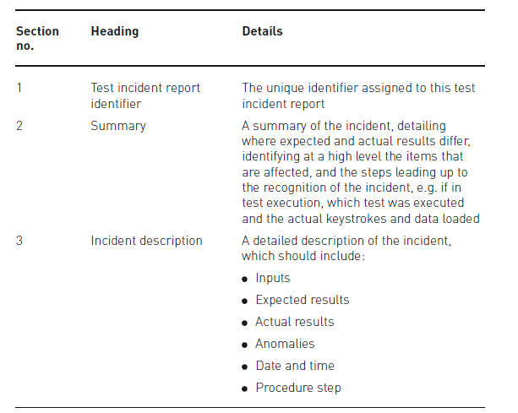
… INCIDENT MANAGEMENT …
Test incident report outline …

Slide 7
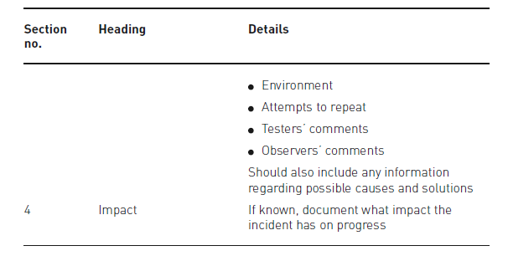
… INCIDENT MANAGEMENT …
… Test incident report outline

Slide 8
CONFIGURATION MANAGEMENT…
configuration management is in part about determining clearly what the items are that make up the software or system.
These items include source code, test scripts, third-party software, hardware, data and both development and test documentation.
Configuration management is also about making sure that these items are managed carefully, thoroughly and attentively throughout the entire project and product life cycle.
Configuration management has a number of important implications for testing.
For one thing, it allows the testers to manage their testware and test results using the same configuration management mechanisms, as if they were as valuable as the source code and documentation for the system itself - which of course they are.
For another thing, configuration management supports the build process, which is essential for delivery of a test release into the test environment.
Simply sending Zip archives by e-mail will not suffice, because there are too many opportunities for such archives to become polluted with undesirable contents or to harbor left-over previous versions of items.
Especially in later phases of testing, it is critical to have a solid, reliable way of delivering test items that work and are the proper version.

Slide 9
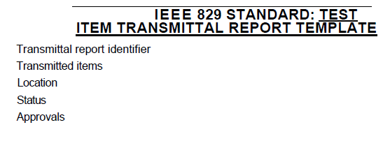
… CONFIGURATION MANAGEMENT …
Last but not least, configuration management allows us to map what is being tested to the underlying files and components that make it up.
This is absolutely critical. For example, when we report defects, we need to report them against something, something which is version controlled.
If it's not clear what we found the defect in, the programmers will have a very tough time of finding the defect in order to fix it.
For the kind of test reports discussed earlier to have any meaning, we must be able to trace the test results back to what exactly we tested.
Ideally, when testers receive an organized, version-controlled test release from a change-managed source code repository, it is accompanied by a test item trans-mittal report or release notes.
[IEEE 829] provides a useful guideline for what goes into such a report. Release notes are not always so formal and do not always contain all the information shown.

Slide 10
… CONFIGURATION MANAGEMENT
While our description was brief, configuration management is a topic that is as complex as test environment management.
So, advanced planning is critical to making this work.
During the project planning stage - and perhaps as part of your own test plan - make sure that configuration management procedures and tools are selected.
As the project proceeds, the configuration process and mechanisms must be implemented, and the key interfaces to the rest of the development process should be documented.
Come test execution time, this will allow you and the rest of the project team to avoid nasty surprises like testing the wrong software, receiving uninstallable builds and reporting irreproducible defects against versions of code that don't exist anywhere but in the test environment.

